Slide 1

Smart Exercise & Fitness Tracker Web App
Guide:
Prof. Hiten Sadani
Team Members:
22012011048_Hill Soni
22012011050_Bansi Vachhani
22012011065_Bhakti Kansagara

Slide 2
Vision and Mission of Ganpat University
Vision | It shall be the constant endeavour of Ganpat University to meet the educational needs of the youth in the areas of professional studies and provide state-of the art learning opportunities along with inculcation of values of commitment and uprightness.
Mission | Seek, search and offer programs that lead to symbiotic emergence of 'academic excellence' and 'industrial relevance' in education and research.

Slide 3
Vision and Mission of Computer Engineering Department
Vision | Department aims to achieve its recognition as a leading contributor in the area of technical education of computer engineering by practicing latest principles, tools and technologies to cope with current and future challenges and hence contributing to global welfare.
Mission | To educate and inculcate strong fundamentals of science and computer engineering through best teaching learning practices. To impart high quality education to acquire skills to conduct research and solve complex problems through modern tools, technologies and innovative practices. Enabling youth for employability, social upliftment, following good moral practices and professional ethics. Preparing youth for contributing in advancements of technology and society. Encouraging students to be adaptive, courageous and life-long learners.

Slide 4
Problem Definition:
Many people find it hard to maintain a healthy lifestyle because of poor planning, inconsistent routines, and limited access to reliable fitness advice. Current fitness solutions often focus on just one part, like diet or exercise, and do not offer a complete approach that includes nutrition, workouts, yoga, motivation, and personal support.
Without ongoing guidance and motivation, users frequently lose track of their progress. They struggle to stick to sustainable workout plans and do not have real-time help for their fitness questions. This results in irregular habits, poor diet management, and difficulty reaching long-term fitness goals.
Thus, there is a need for a user-friendly and smart fitness platform that combines diet management, exercise routines, yoga guidance, fitness challenges, AI chatbot support, and personalized workout plans into one system. This would help users stay consistent, motivated, and focused on their health and wellness journey.
Proposed Solution:
The Smart Exercise & Fitness Tracker Web App aims to give users a dependable, interactive, and smart way to manage their fitness journey. The system addresses common problems like inconsistency, poor planning, and limited access to professional guidance in fitness. The Smart Exercise & Fitness Tracker Web App is a complete fitness tool. It helps users improve their health through diet management, exercise routines, yoga guides, fitness challenges, AI chatbot support, and personalized workout plans. The app emphasizes usability, motivation, and personalization. It addresses common issues such as poor planning and lack of guidance. This enables users to reach their long-term fitness goals.

Slide 5
Minimum Software Requirements:
For Users:
Operating System: Windows , macOS, or Linux (Ubuntu 20.04+)
Browser: Google Chrome, Mozilla Firefox, or Edge
For Developers:
Operating System: Windows 10 / Linux Ubuntu 20.04 / macOS 10.15 or higher
Frontend: React.js, Bootstrap / Material UI , Tailwind CSS
Backend: Python (Flask or FastAPI)
Database & Auth: Firebase (Firestore + Firebase Auth)
AI / ML: scikit-learn, TensorFlow / external API for calorie estimation
Other Tools: GitHub (version control), Figma (UI design), Postman (API testing)

Slide 6
Minimum Hardware Requirements:
For Users:
Device: Laptop, desktop, or smartphone with a modern web browser
Processor: Dual-core 1.8 GHz or higher
RAM: 2 GB
Storage: 200 MB free space (for cached data)
Internet: Minimum 2 Mbps connection
For Developers:
Processor: Intel i3 (7th Gen) / AMD equivalent
RAM: 4 GB
Storage: 120 GB HDD or 64 GB SSD
Internet: Stable connection (2–4 Mbps)

Slide 7
Functional Requirements:
User Authentication – Secure login, registration, and profile management.
Diet Management – Personalized diet plans, food logging, calorie tracking.
Workout Plans – Custom exercise routines with progress tracking.
Yoga Guidance – Library of yoga poses and routines.
Fitness Challenges – Daily/weekly challenges for motivation.
AI Chatbot – Instant answers and suggestions for fitness queries.
Dashboard & History – Track progress with logs and export option.
Privacy & Security – Consent, data protection, and secure sharing.

Slide 8
Non-Functional Requirements:
Performance – The system should load the dashboard and chatbot responses within 2–3 seconds.
Scalability – The app must support increasing users without performance issues.
Usability – Interface should be simple, responsive, and easy to navigate for all age groups.
Reliability – The app should ensure 99% uptime and handle errors gracefully.
Portability – The system should work across devices (desktop, laptop, tablet, mobile).
Maintainability – Code should be modular, well-documented, and version-controlled (GitHub).
Accuracy – Calorie estimation and progress tracking must maintain acceptable error bounds.
Availability – The system must be accessible 24/7 with minimal downtime.

Slide 9
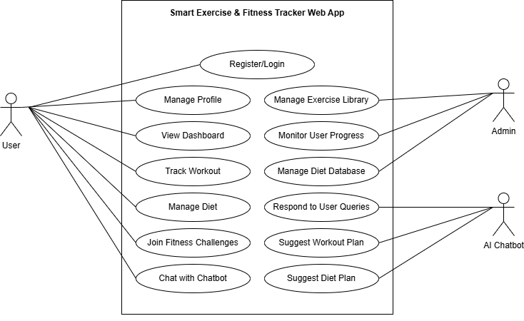
Use Case Diagram:

Slide 10
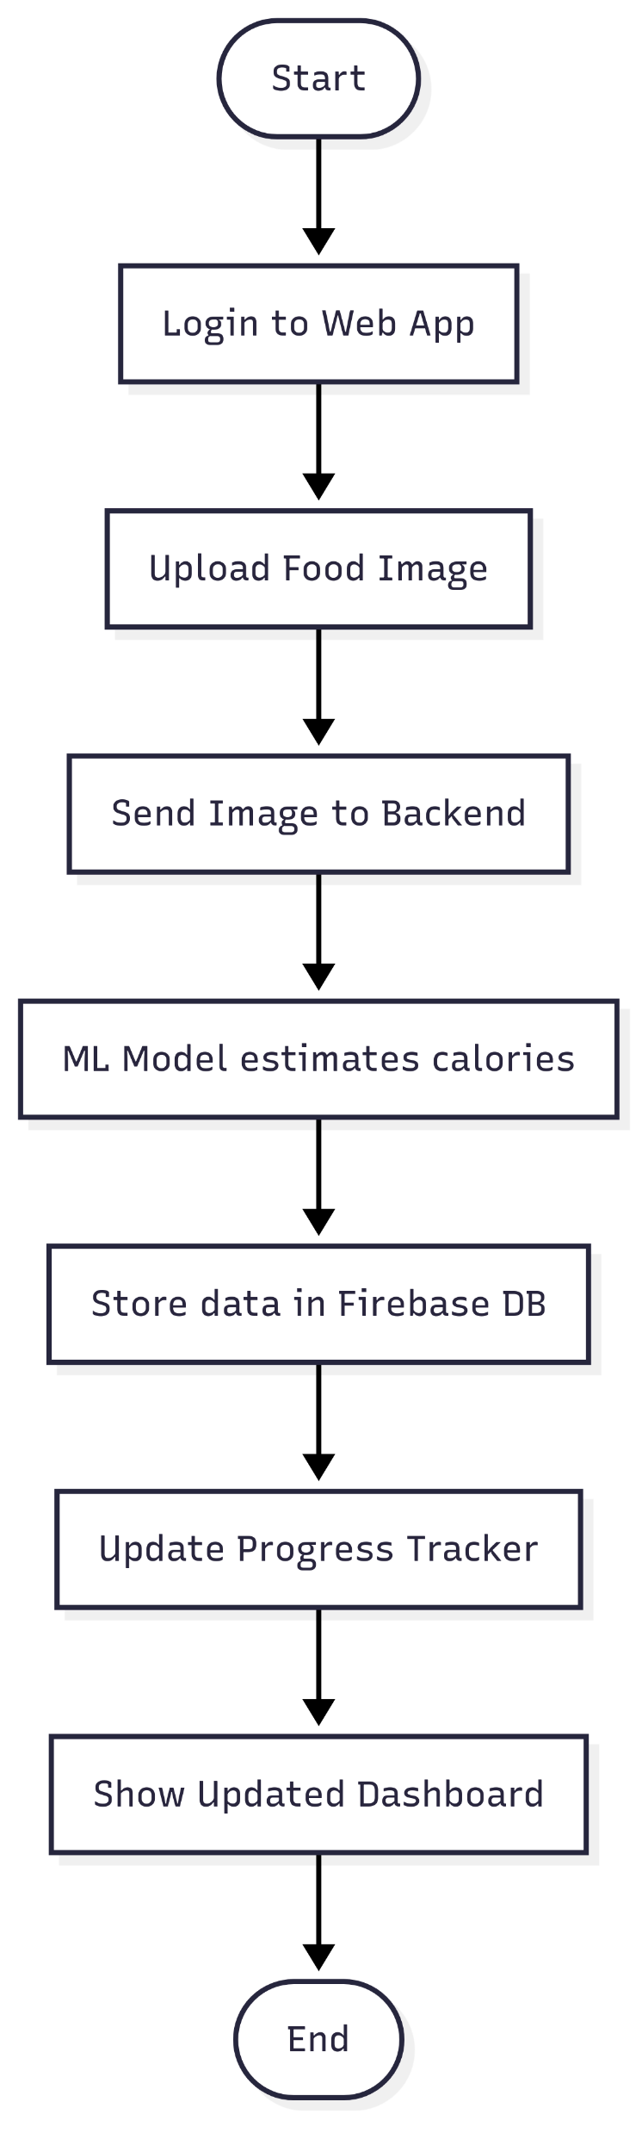
Activity Diagram:

Slide 11
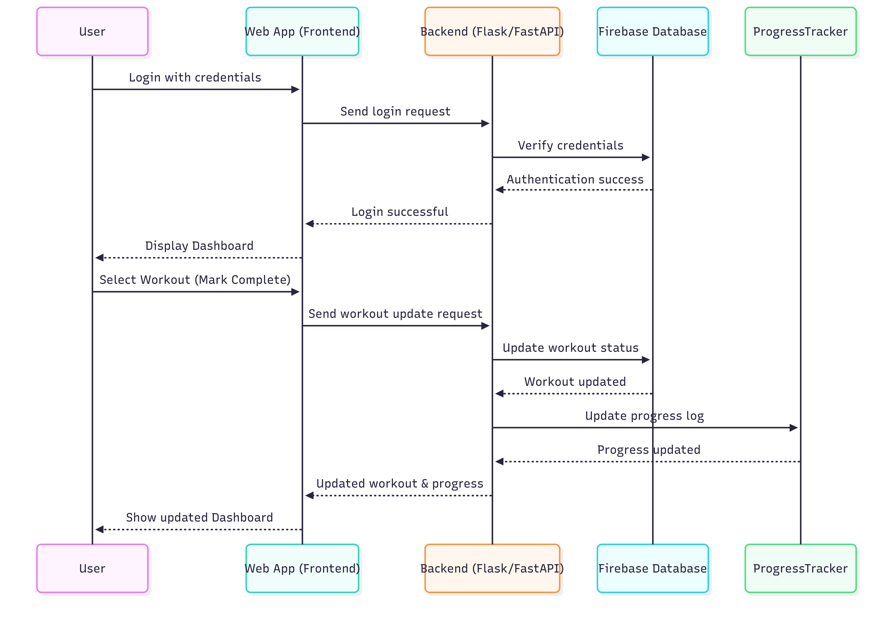
Sequence Diagram:

Slide 12
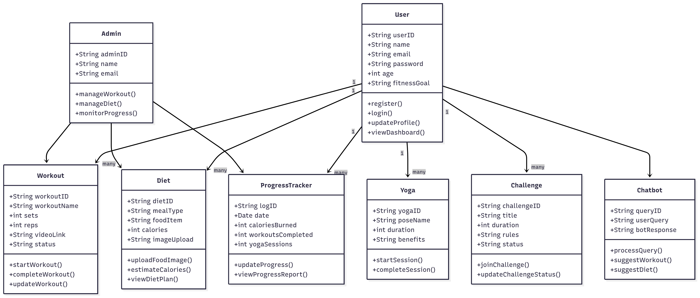
Class Diagram:

Slide 13
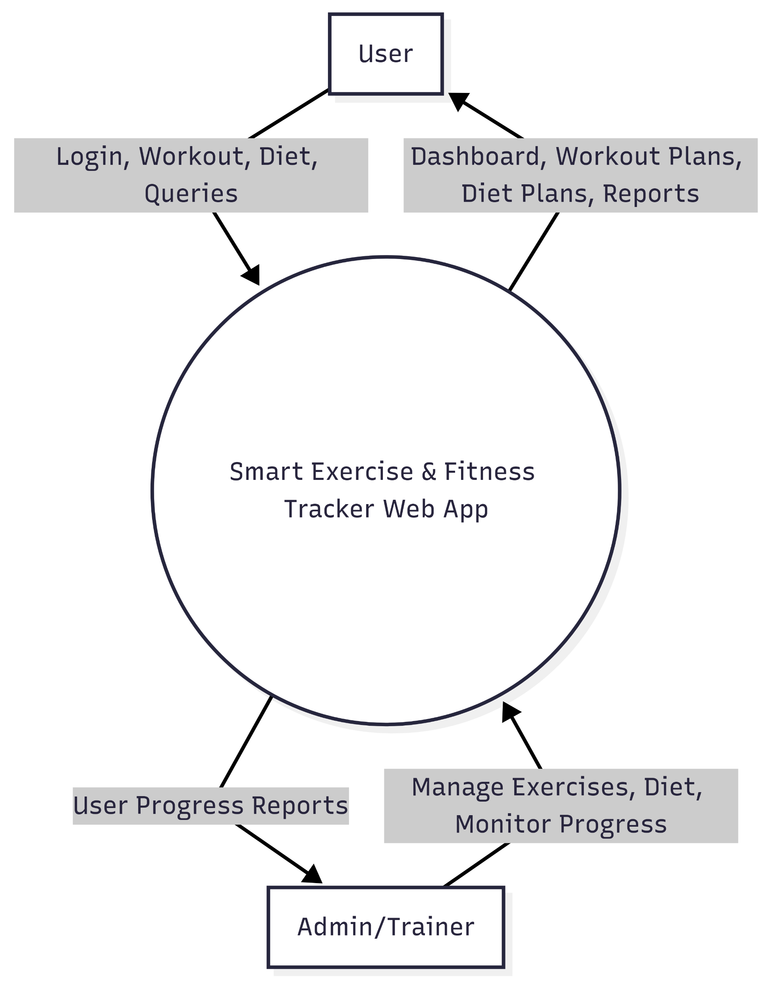
DFD (level-0):

Slide 14
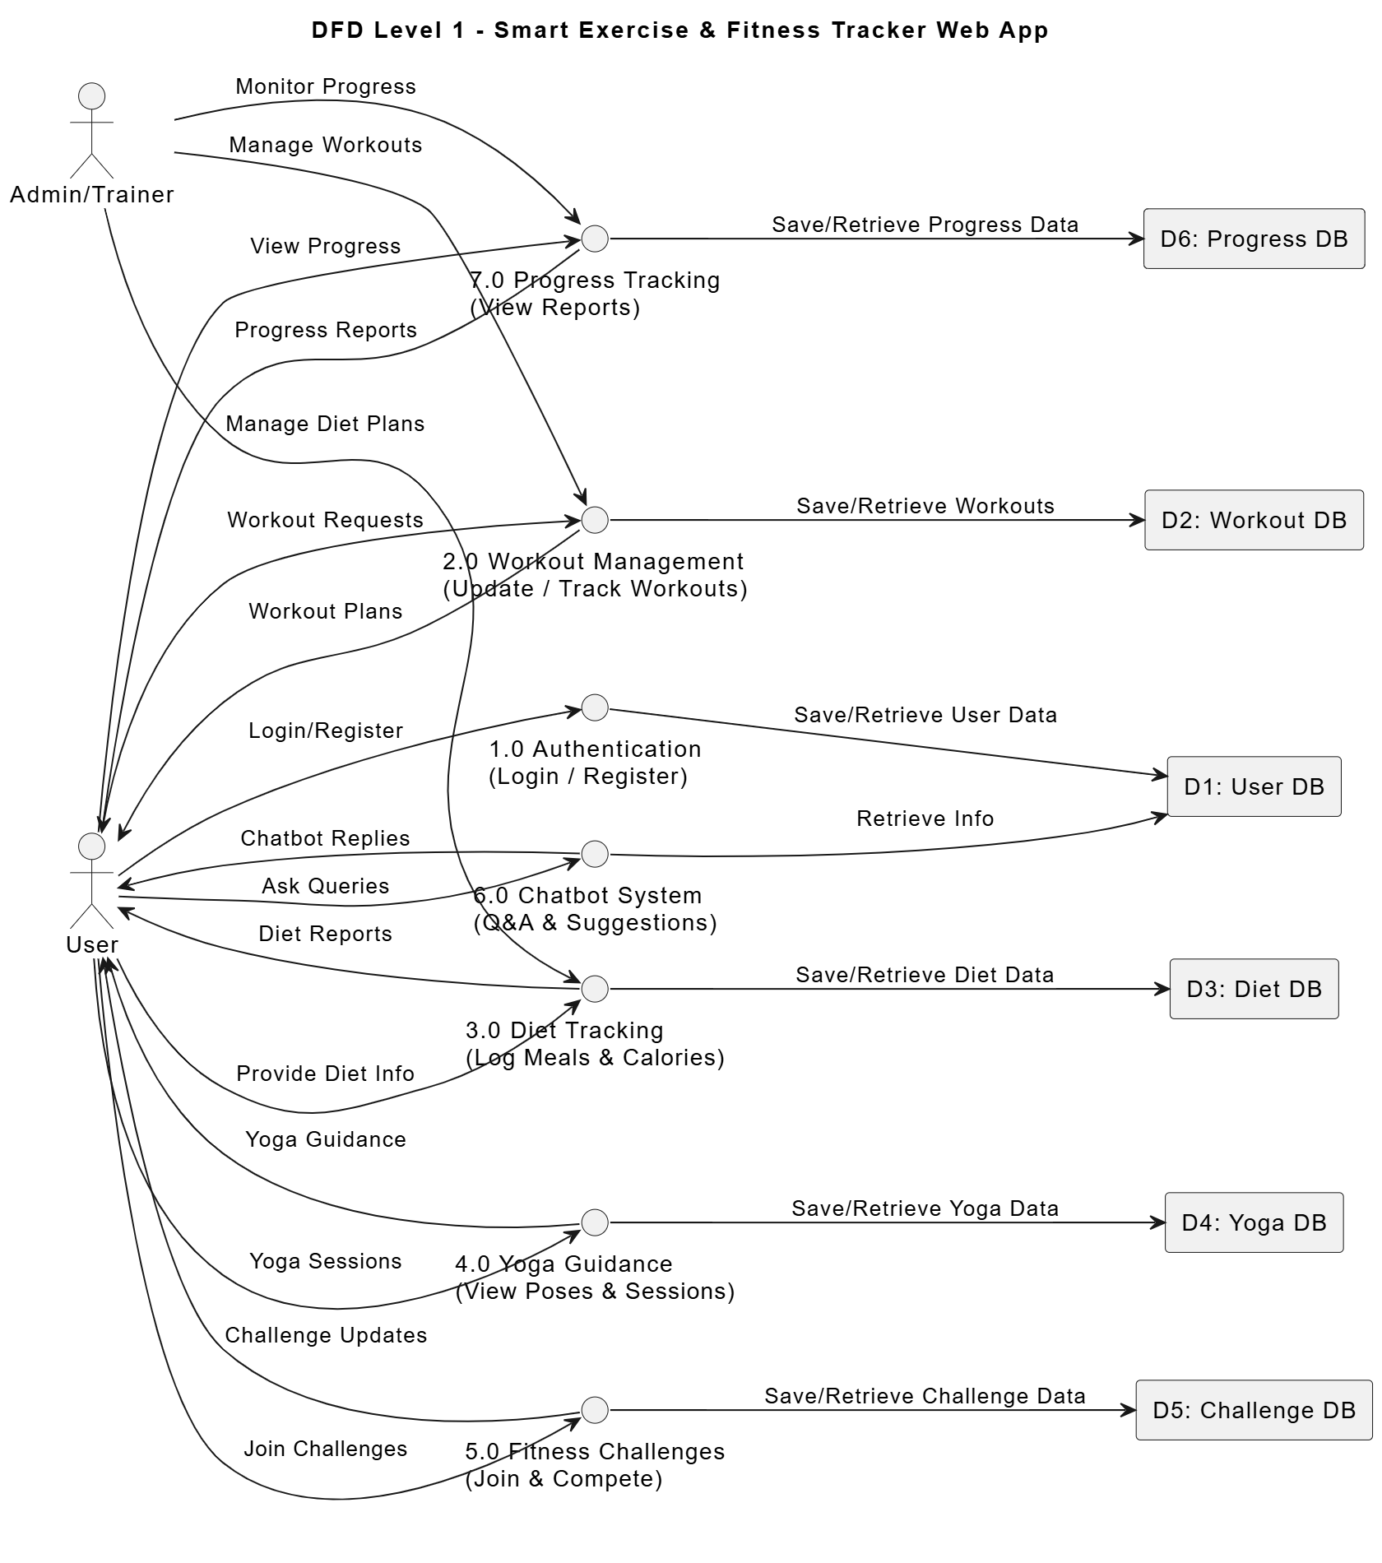
DFD (level-1):

Slide 15
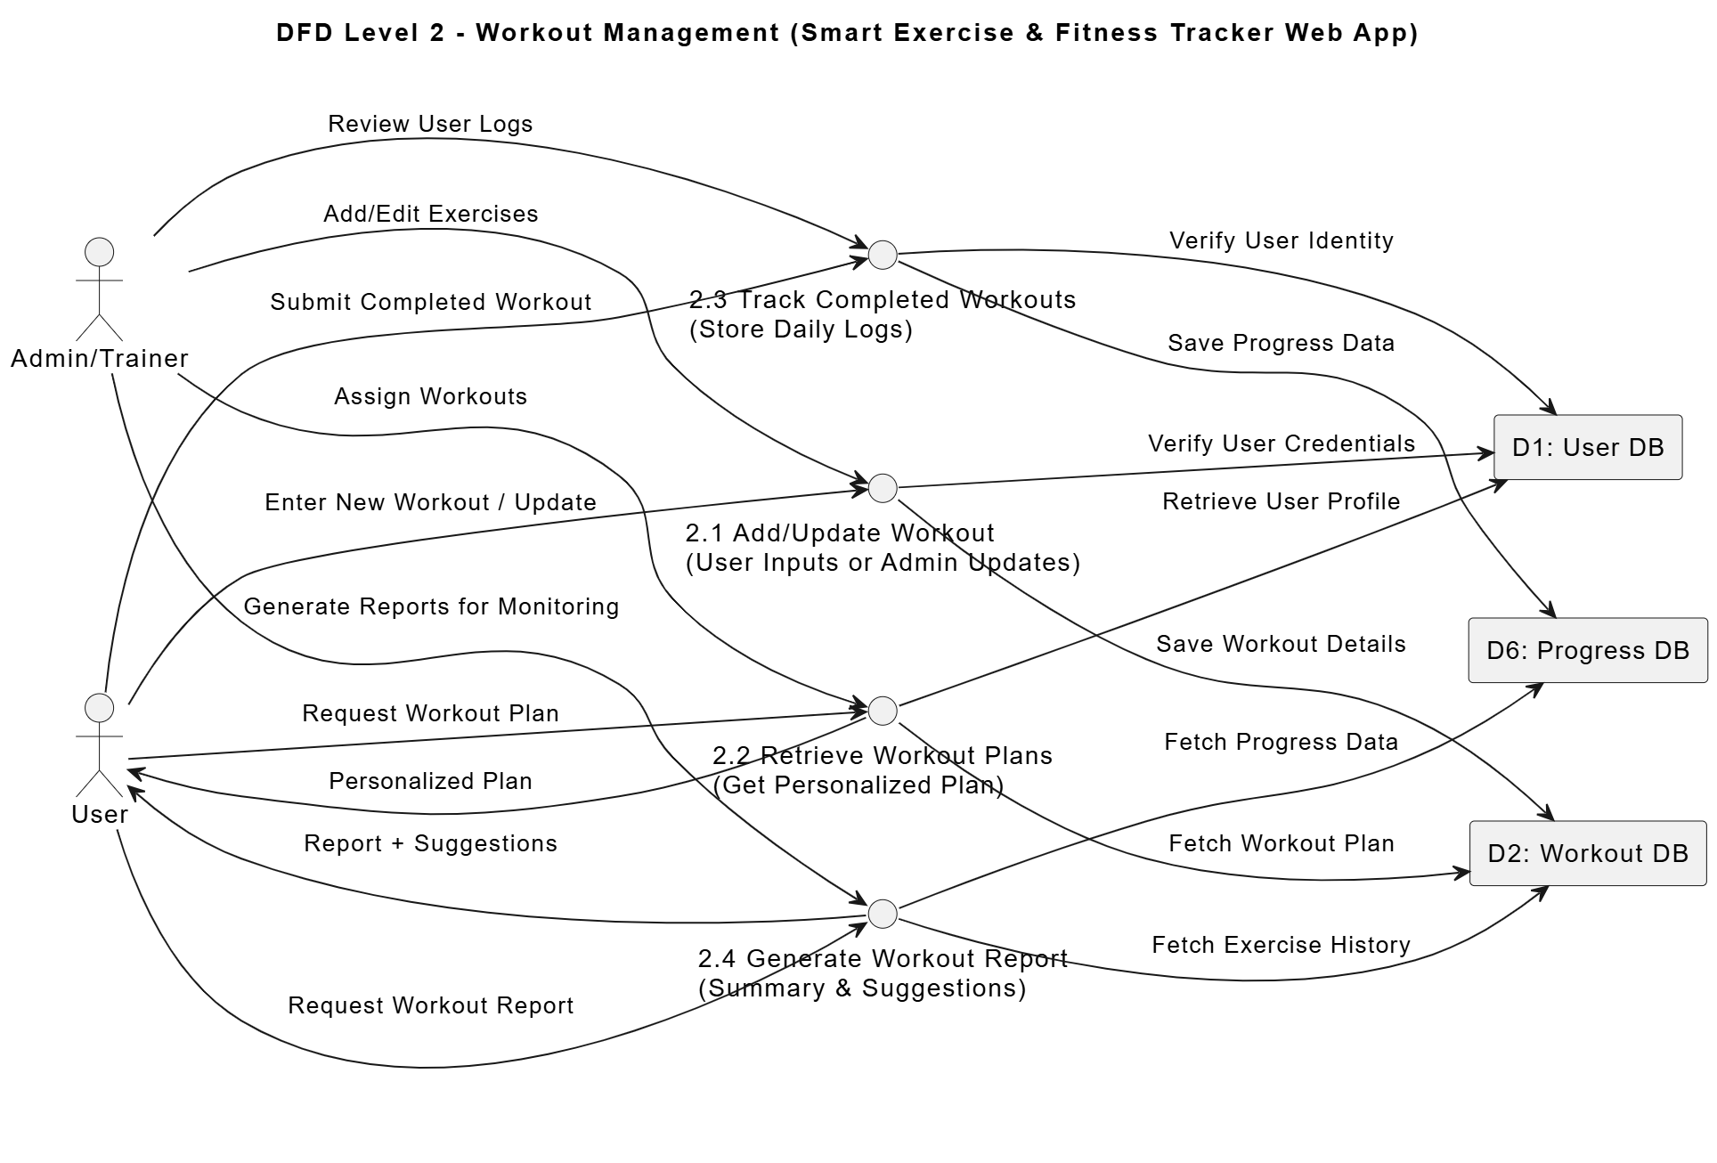
DFD (level-2) :

Slide 16
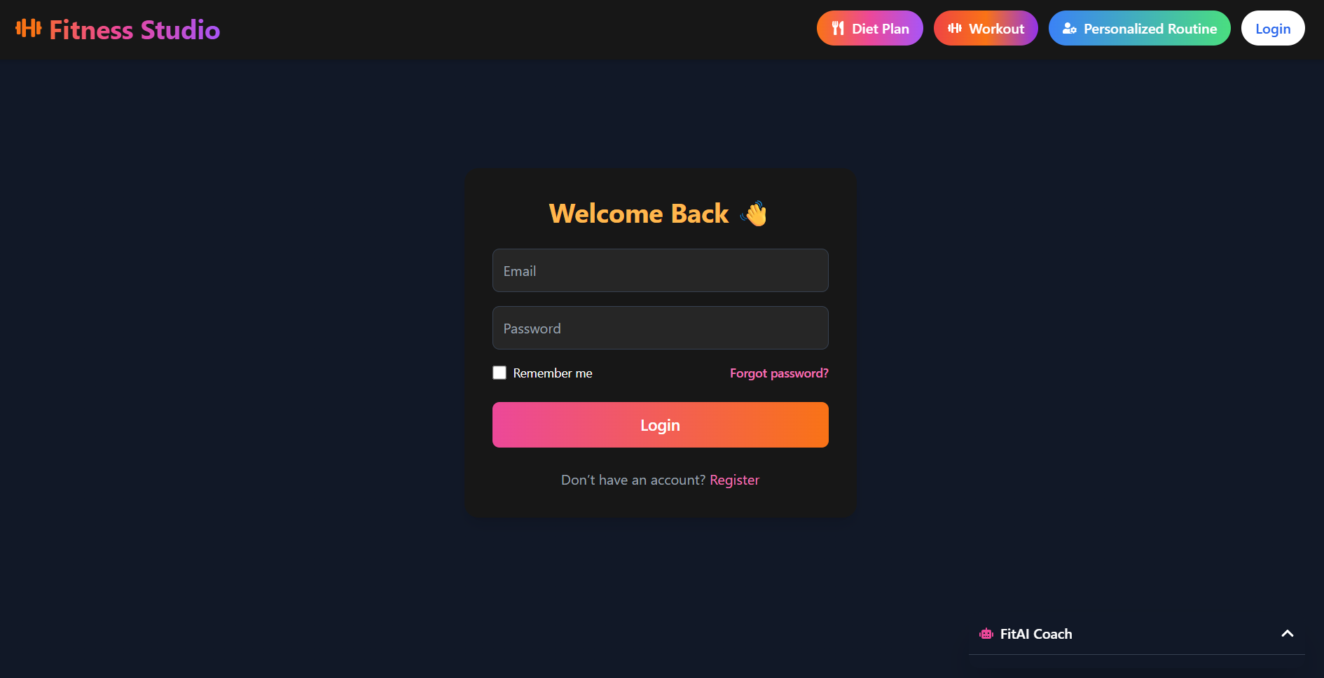
Login Screen:

Slide 17
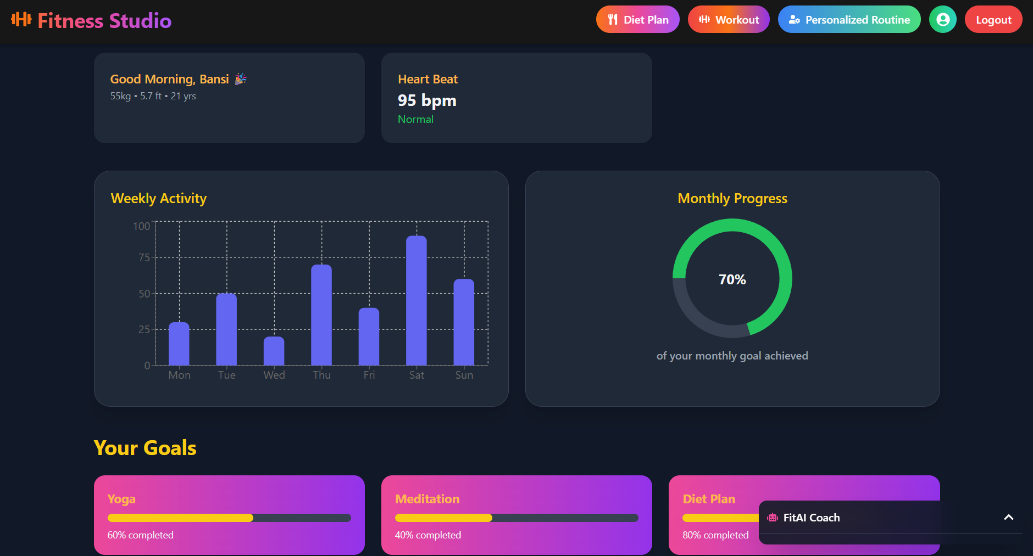
User Dashboard:

Slide 18
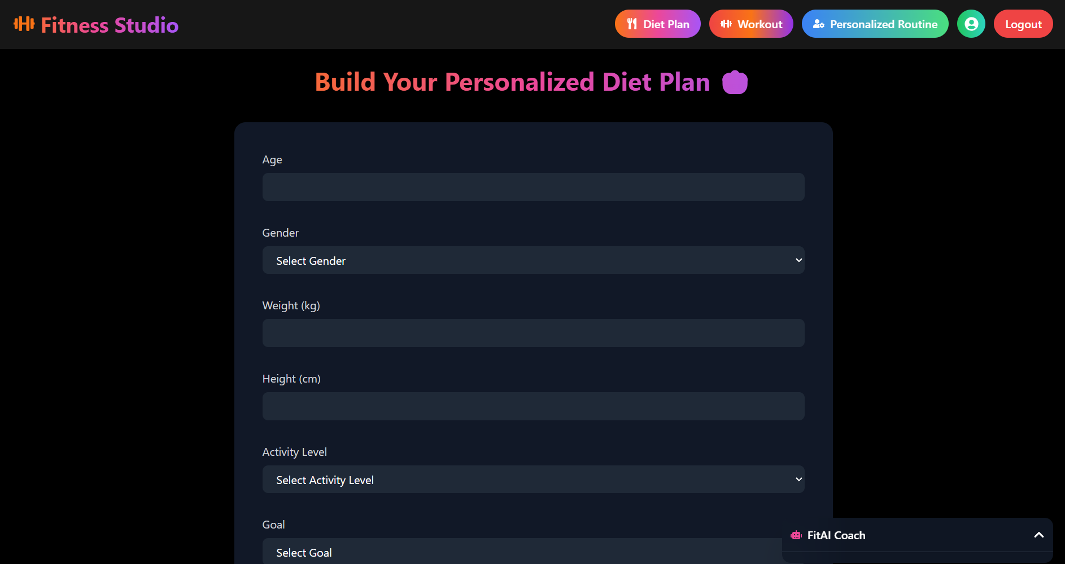
Diet Plan Page:

Slide 19
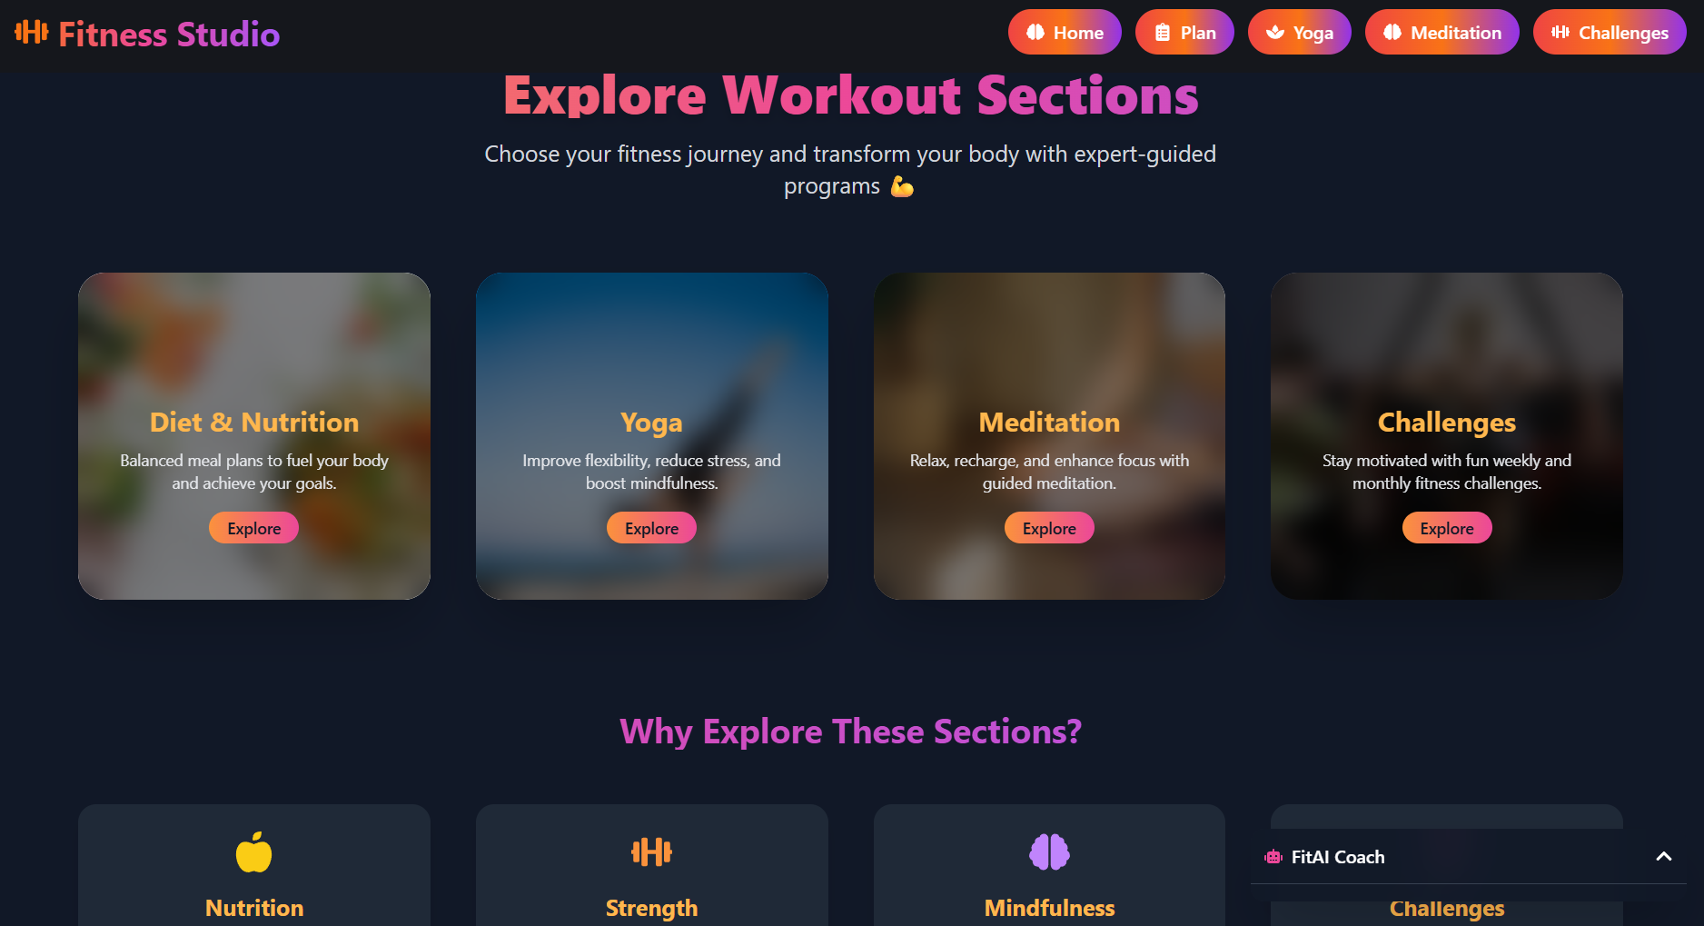
Workout Section Page:

Slide 20
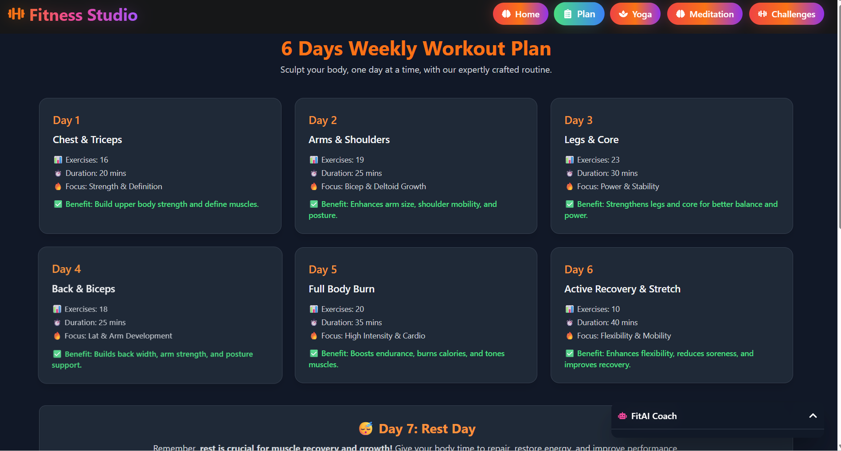
Days Plan Page:

Slide 21
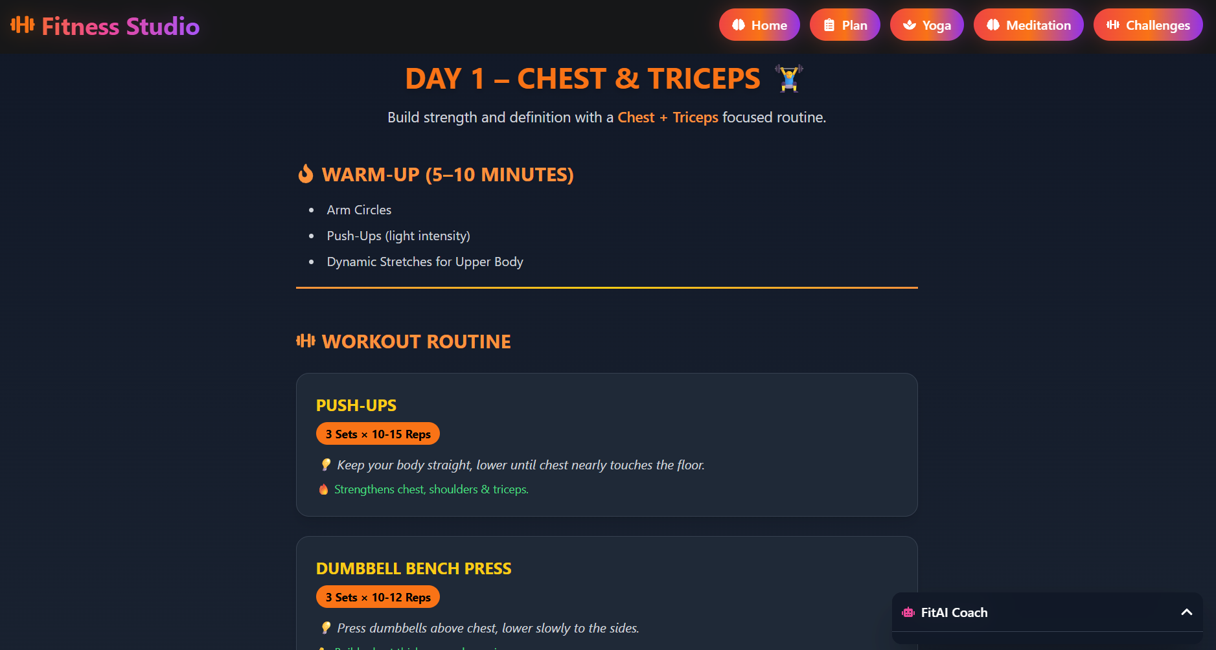
Day-1 Plan:

Slide 22
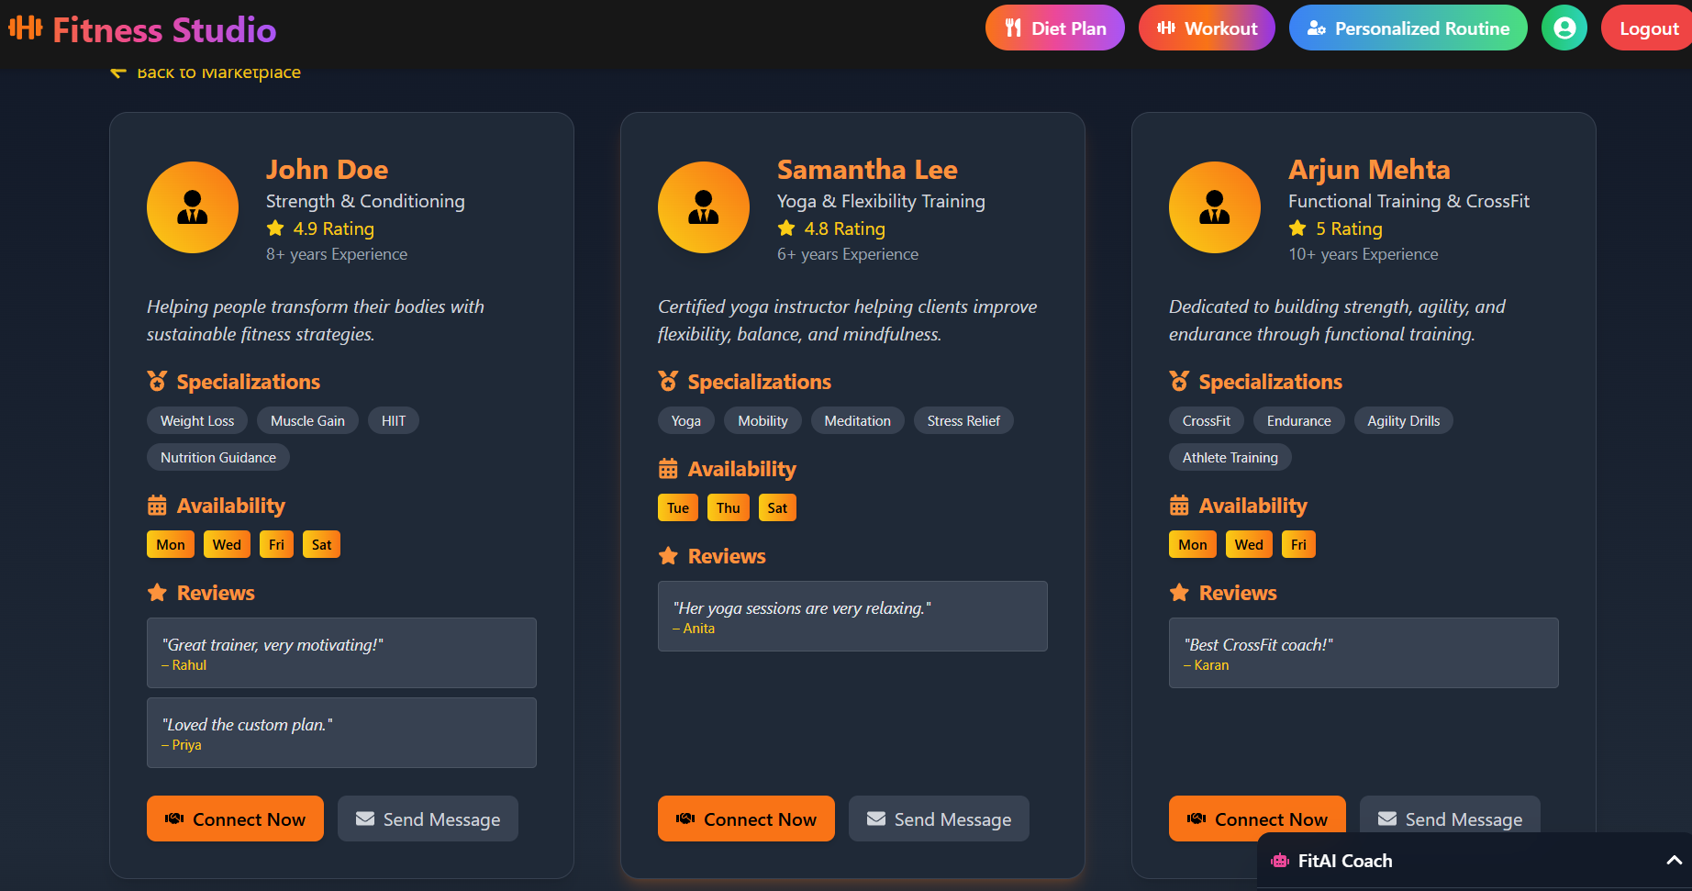
Coach Page :

Slide 23
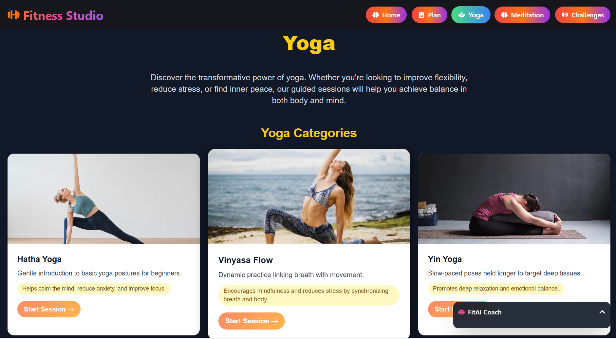
Yoga Page :

Slide 24
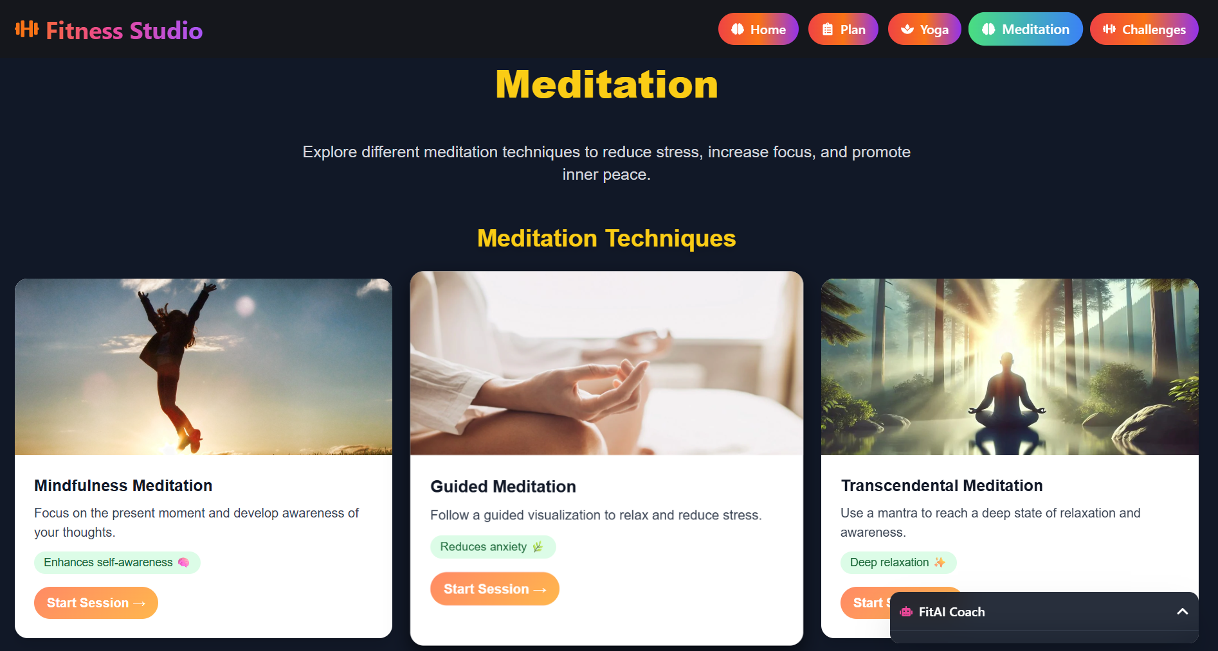
Meditation Page:

Slide 25
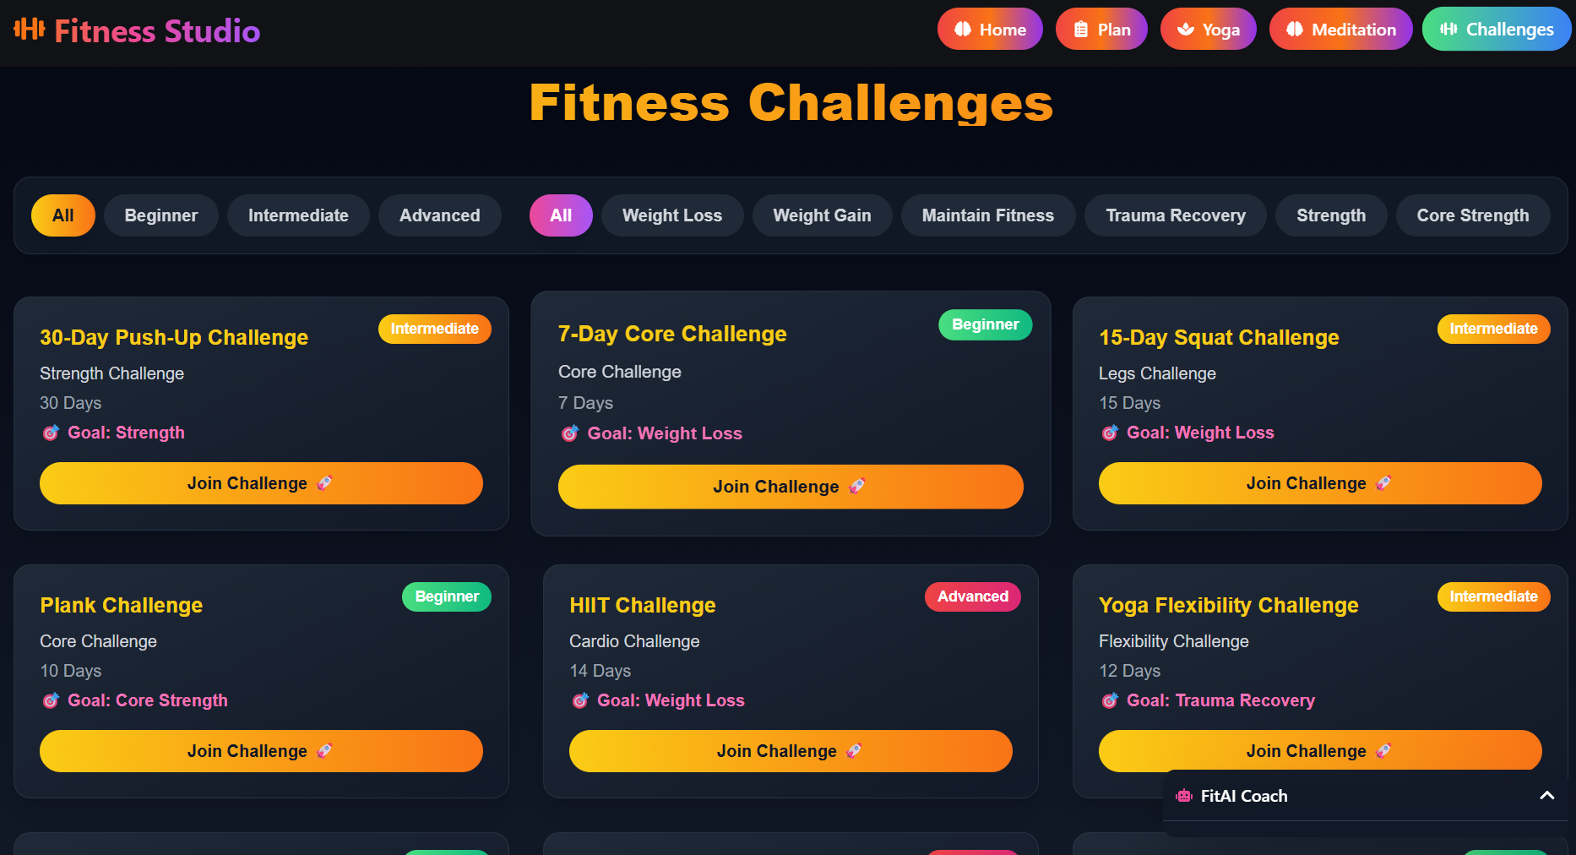
Challenges Page :

Slide 26
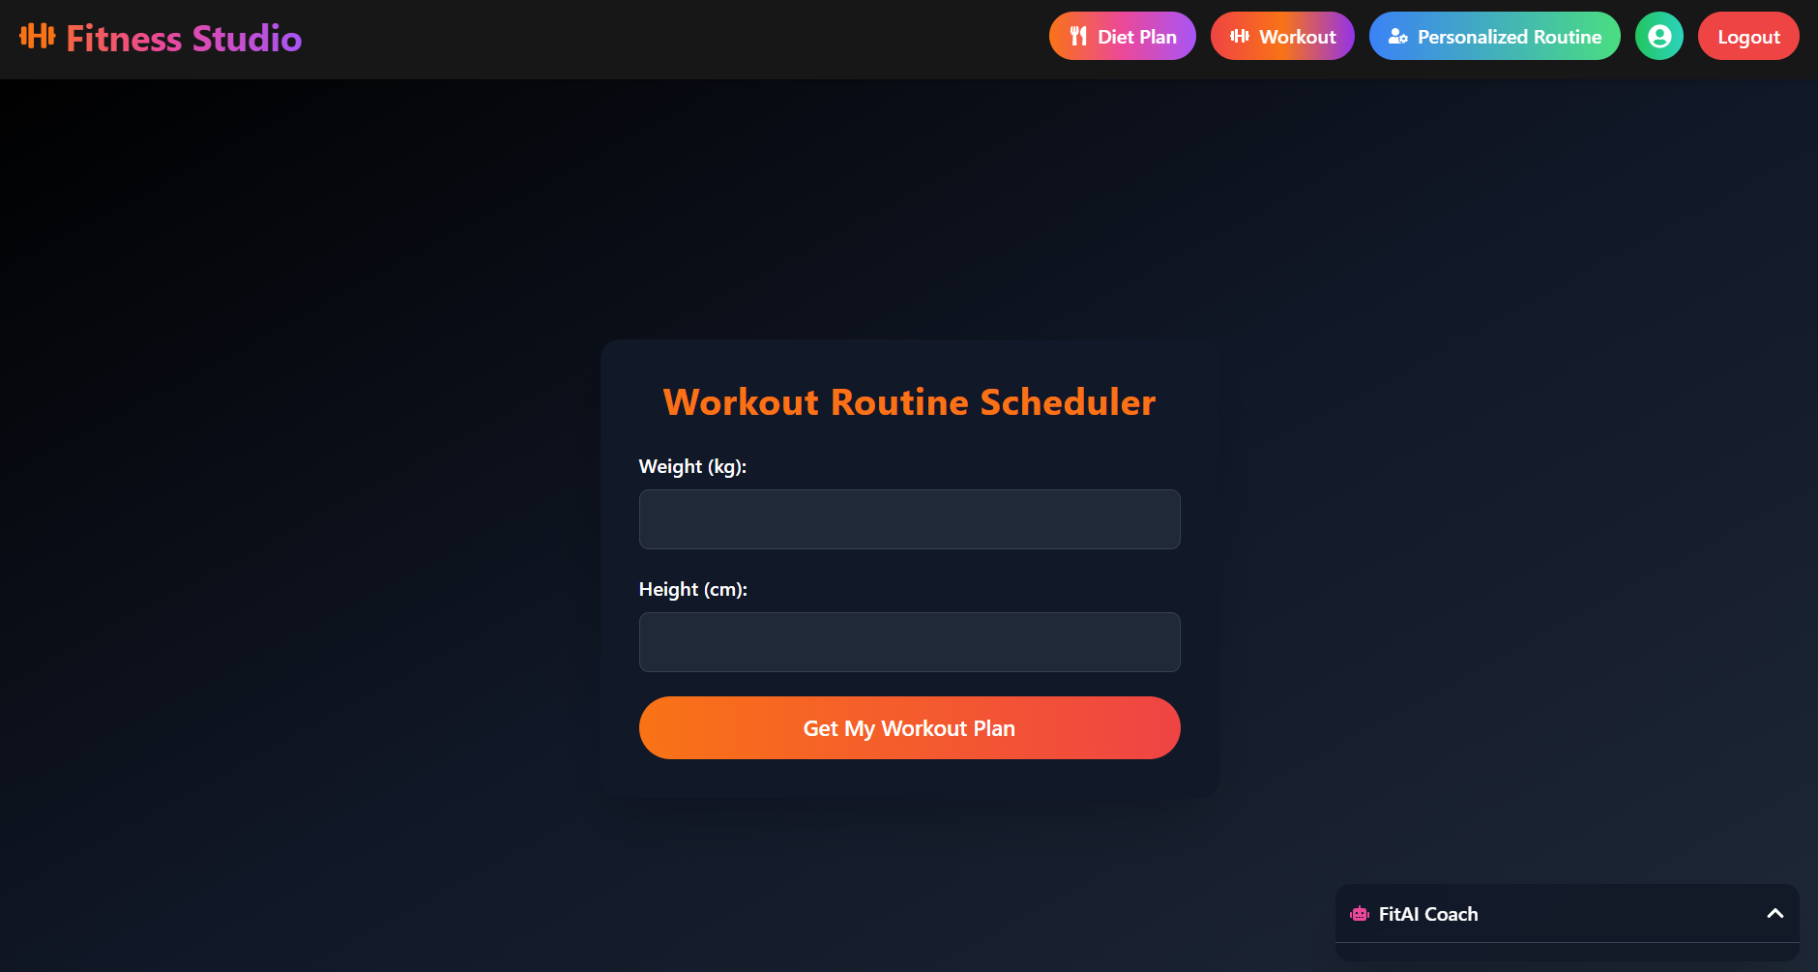
Personalized Routine Page:

Slide 27
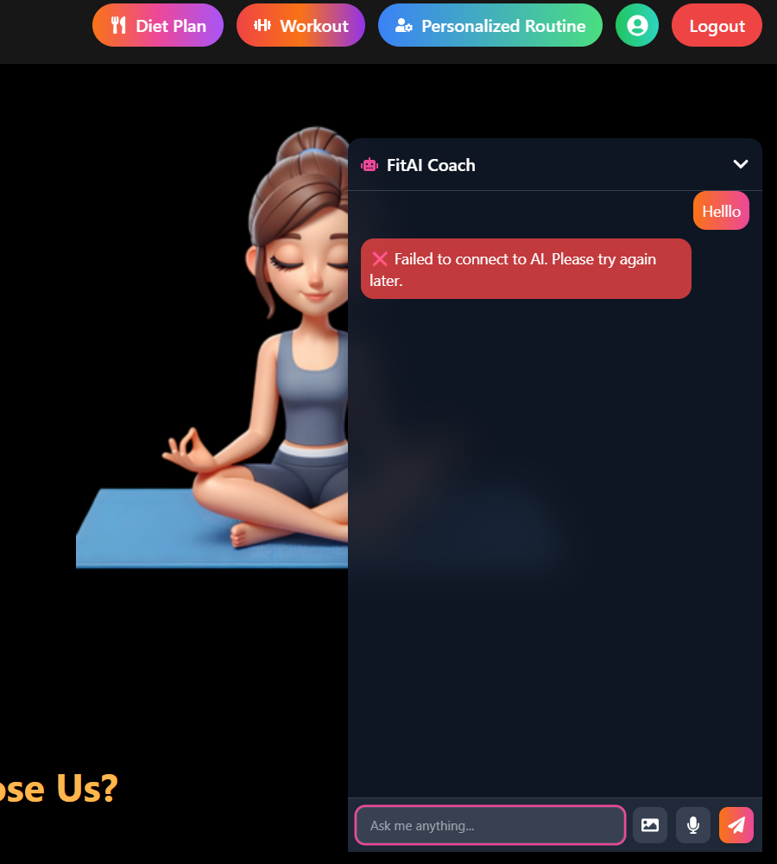
Chatbot Page:

Slide 28
Tools and Technology:
Frontend Development
React.js: A powerful JavaScript library for building fast and responsive user interfaces, used to design the dashboard, chatbot interface, and interactive modules.
Bootstrap / Material UI: Component libraries for responsive layouts and professional UI elements.
Backend Development:
Python (Flask or FastAPI): Lightweight backend frameworks used to handle APIs, chatbot integration, and ML pipelines for calorie estimation.
Firebase (Firestore + Firebase Auth): Provides secure authentication and real-time database services for storing user data, workout routines, and history.
APIs & AI Models: Integration of TensorFlow/scikit-learn for calorie estimation and chatbot recommendations.
AI / Machine Learning:
Food Image Recognition Model: Estimates calories from uploaded food images.
Natural Language Processing (NLP): Powers the chatbot for understanding user queries and generating personalized responses.

Slide 29
Tools and Technology:
Additional Tools and Considerations:
Version Control: GitHub for code management, version control, and team collaboration.
UI/UX Design: Figma for wireframing and prototyping an intuitive user interface.
API Testing: Postman for testing backend APIs and ensuring smooth integration.
Testing Frameworks: Jest and React Testing Library for unit testing; PyTest for backend testing.
Deployment Platforms: Web deployment on cloud platforms (e.g., Vercel, Netlify for frontend, and Heroku/Render for backend).

Slide 30
Conclusion:
The Smart Exercise & Fitness Tracker Web App has been successfully developed to serve as an all-in-one platform for managing personal fitness. Unlike traditional methods that rely on multiple apps or manual logging, this system integrates workout plans, diet tracking, yoga routines, calorie estimation, fitness challenges, and chatbot assistance into a single, user-friendly application.
Built with React.js (frontend) and Python Flask/FastAPI (backend), along with Firebase authentication and AI/ML models for intelligent recommendations, the system ensures accuracy, scalability, and secure data management. Users can easily track their progress through a dashboard, interact with an AI-powered chatbot, and stay motivated with fitness challenges and history logs.
The project is technically, operationally, and economically feasible, as it leverages open-source technologies, requires no special hardware, and remains cost-effective through free-tier cloud services. It demonstrates how modern web technologies and AI can simplify health management while remaining accessible to users with minimal technical knowledge.

Slide 31
Future Work:
AI Personalization – Smarter adaptive fitness and diet plans.
Wearable Integration – Real-time tracking via smartwatches/bands.
Mobile Apps – Android/iOS versions for on-the-go access.
Gamification – Badges, leaderboards, and rewards for motivation.
Community Support – Connect with peers/trainers for guidance.
Multilingual Support – Accessibility for a global audience.
External APIs – Better diet and workout recommendations.
Predictive Analytics – AI to forecast health risks.
UI/UX Upgrades – More engaging and user-friendly design.

Slide 32
References:
R. Patel, S. Mehta, “AI-Powered Fitness Tracking and Personalized Health Recommendation System,” (2021), International Journal of Computer Applications, Volume 183, Issue 15, Foundation of Computer Science (FCS).
A. Sharma, M. Gupta, “Design and Development of an Intelligent Health and Fitness Monitoring System Using IoT and Machine Learning,” 2020 IEEE International Conference on Computing, Communication and Intelligent Systems (ICCCIS), pp. 215–220, 2020, https://ieeexplore.ieee.org/document/9397087
K. Verma, P. Singh, “Personalized Diet and Workout Recommendation System Using Machine Learning,” (2019), International Journal of Innovative Research in Computer and Communication Engineering (IJIRCCE).
Firebase Documentation. (n.d.). Firebase Authentication and Cloud Firestore. Retrieved from https://firebase.google.com/docs
React Team, Meta. (n.d.). React.js Documentation – A JavaScript Library for Building User Interfaces. Retrieved from https://react.dev
FastAPI Documentation. (n.d.). FastAPI: Modern, Fast (High-performance) Web Framework for Python. Retrieved from https://fastapi.tiangolo.com
TensorFlow Developers. (n.d.). TensorFlow: An End-to-End Open Source Machine Learning Platform. Retrieved from https://www.tensorflow.org
scikit-learn Developers. (n.d.). scikit-learn: Machine Learning in Python. Retrieved from https://scikit-learn.org

Slide 33
Thank You

